Slide 1
PROJECT PRESENTATION
SUBMITTED
TO
DEPARTMENT OF COMPUTER SCIENCE AND ENGINEERING
FOR
LAB ORIENTED PROJECT

Slide 2
Submitted By:-
Name: Vidhyun Kapoor
University Roll No: 1810991180
Semester: 7th
Session: 2018-2022

Slide 3
Problem Statement
In today’s world, people have a lot of work which requires strong vocabulary of English language along with a decent grip on grammar. Some people tend to struggle while finding the correct word required to form a sentence to make a better understanding for everyone. The aim of this project is preparing a platform that can help the users by suggesting meaningful words in between any sentence they are struggling to form.

Slide 4
Title of project
Masked Word Finder

Slide 5
Objective & Key Learnings
To enable the student to understand the concept of NLP and Deep Learning.
To understand the difference in outputs by several frameworks like BERT, XLNET, XLM-Roberta, BART, ELECTRA and ROBERTA.
To ensure that the user won't find difficulties to use appropriate words by using the suggestions given by the word predictor.

Slide 6
Requirements to execute the project
Anaconda Spyder IDE
NLP frameworks
Understanding of Deep Learning
HTML, CSS and JavaScript for Frontend

Slide 7
Alternative options to execute the project
This project can also be executed using :-
Jupiter Notebook
PyCharm

Slide 8
What is NLP?
Natural language processing (NLP) is a subfield of linguistics, computer science, and artificial intelligence concerned with the interactions between computers and human language, in particular how to program computers to process and analyze large amounts of natural language data. The result is a computer capable of "understanding" the contents of documents, including the contextual nuances of the language within them. The technology can then accurately extract information and insights contained in the documents as well as categorize and organize the documents themselves.

Slide 9
Use of NLP in Word Prediction
In a text prediction task, a sentence, or series of words, is presented to a prediction model. The model’s task is to then present the word or words with the highest probability of following the initial series to the user.
For the output, I have used different NLP frameworks which showcases stage by stage improvement in each prediction.

Slide 10
Frameworks used
BERT : It stands for Bidirectional Encoder Representations from Transformers. It is designed to pre-train deep bidirectional representations from unlabeled text by jointly conditioning on both left and right context.
XLNET : Generalized Auto-Regressive model for NLU. It has more computational power to achieve better than BERT prediction metrics on 20 language tasks.
XLM-Roberta : XLM-Roberta is a multilingual model trained on 100 different languages. Unlike some XLM multilingual models, it does not require lang tensors to understand which language is used, and should be able to determine the correct language from the input ids.

Slide 11
BART : Bidirectional and Auto-Regressive Transformer. Combines BERT with autoregressive decoder.
ELECTRA : ELECTRA is a method for self-supervised language representation learning. It can be used to pre-train transformer networks using relatively little compute. ELECTRA models are trained to distinguish "real" input tokens vs "fake" input tokens generated by another neural network.
ROBERTA : ROBERTA builds on BERT's language masking strategy and modifies key hyperparameters in BERT, including removing BERT's next-sentence pretraining objective, and training with much larger mini-batches and learning rates.

Slide 12
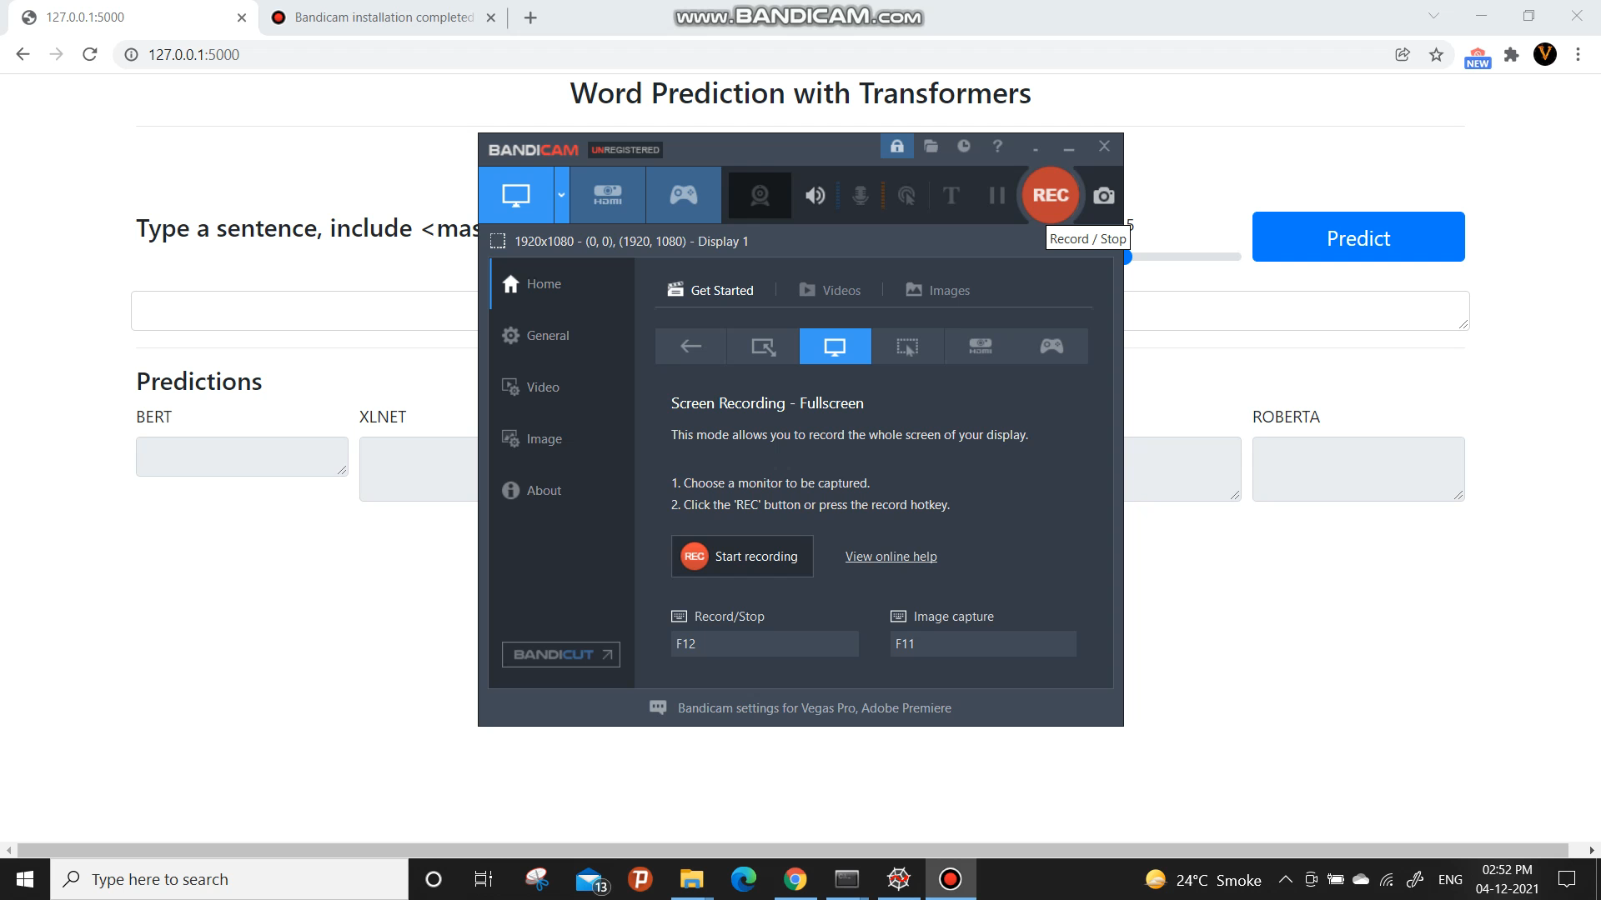
Working of project

Slide 13
References
https://www.w3schools.com/ - for frontend development
https://towardsdatascience.com/ - to see the working of the technologies used in the project
https://github.com/ - to go through various projects developed by R and Python which gave a decent idea about the development

Slide 14
END OF PRESENTATION
Thank you!

